Slide 1

Chapter 5: Project Scope Management
Information Technology Project Management, Seventh Edition
ĐẶNG THỊ THU HÀ – SE
dtthuha79@gmail.com
https://lms.iuh.edu.vn
.

Slide 2
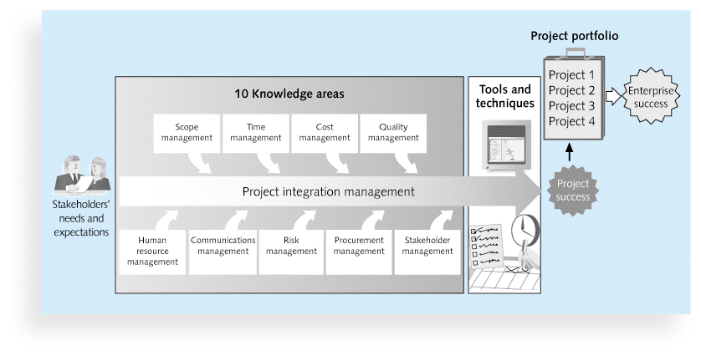

Slide 3
Learning Objectives
Understand the importance of good project scope management
Describe the process of planning scope management
Explain the scope definition process and describe the contents of a project scope statement
Discuss the process for creating a work breakdown structure (WBS) using the analogy, top-down, bottom-up, and mind-mapping approaches
Explain the importance of validating scope and how it relates to defining and controlling scope

Slide 4
What is Project Scope Management?
Scope refers to all the work involved in creating the products of the project and the processes used to create them
A deliverable is a product produced as part of a project, such as hardware or software, planning documents, or meeting minutes
Project scope management includes the processes involved in defining and controlling what is or is not included in a project
Notes:
Deliverables: Các kết quả chuyển giao

Slide 5
Project Scope Management Processes
5.1.Planning scope: determining how the project’s scope and requirements will be managed
5.2.Collecting requirements: defining and documenting the features and functions of the products produced during the project as well as the processes used for creating them
5.3.Defining scope: reviewing the project charter, requirements documents, and organizational process assets to create a scope statement
Notes:
deliverables

Slide 6
Project Scope Management Processes
5.4.Creating the WBS: subdividing the major project deliverables into smaller, more manageable components
5.5.Validating scope: formalizing acceptance of the project deliverables
5.6.Controlling scope: controlling changes to project scope throughout the life of the project

Slide 7
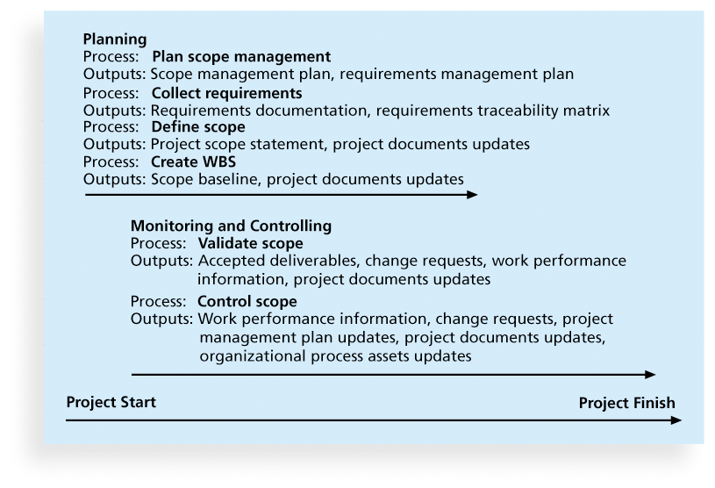
Figure 5-1. Project Scope Management Summary

Slide 8
5.1.Planning Scope Management
The project team uses expert judgment and meetings to develop two important outputs: the scope management plan and the requirements management plan
The scope management plan is a subsidiary part of the project management plan

Slide 9
Scope Management Plan Contents
How to prepare a detailed project scope statement
How to create a WBS
How to maintain and approve the WBS
How to obtain formal acceptance of the completed project deliverables
How to control requests for changes to the project scope
Notes:
Làm thế nào để chuẩn bị một báo cáo phạm vi dự án chi tiết
Cách tạo WBS
Cách duy trì và phê duyệt WBS
Làm thế nào để có được sự chấp nhận chính thức của các sản phẩm dự án đã hoàn thành
Làm thế nào để kiểm soát các yêu cầu thay đổi phạm vi dự án

Slide 10
Requirements Management Plan
The PMBOK® Guide, Fifth Edition, describes requirements as “conditions or capabilities that must be met by the project or present in the product, service, or result to satisfy an agreement or other formally imposed specification”
The requirements management plan documents how project requirements will be analyzed, documented, and managed

Slide 11
5.2.Collecting Requirements
For some IT projects, it is helpful to divide requirements development into categories called elicitation, analysis, specification, and validation
It is important to use an iterative approach to defining requirements since they are often unclear early in a project

Slide 12
Methods for Collecting Requirements
Interviewing
Focus groups and facilitated workshops
Using group creativity and decision-making techniques
Questionnaires and surveys
Observation
Prototyping
Benchmarking, or generating ideas by comparing specific project practices or product characteristics to those of other projects or products inside or outside the performing organization, can also be used to collect requirements

Slide 13
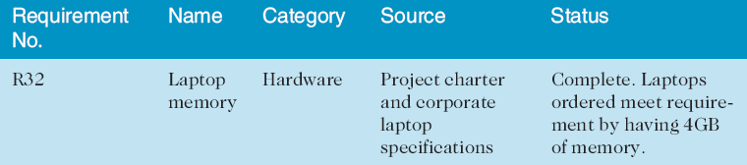
Requirements Traceability Matrix
A requirements traceability matrix (RTM) is a table that lists requirements, various attributes of each requirement, and the status of the requirements to ensure that all requirements are addressed
Table 5-1. Sample entry in an RTM

Slide 14
5.3.Defining Scope
Project scope statements should include at least a product scope description, product user acceptance criteria, and detailed information on all project deliverables. It is also helpful to document other scope-related information, such as the project boundaries, constraints, and assumptions. The project scope statement should also reference supporting documents, such as product specifications
As time progresses, the scope of a project should become more clear and specific which bases on the project charter (Chapter 4).

Slide 15
5..4.Creating the Work Breakdown Structure (WBS)
A WBS is a deliverable-oriented grouping of the work involved in a project that defines the total scope of the project
WBS is a foundation document that provides the basis for planning and managing project schedules, costs, resources, and changes
Decomposition is subdividing project deliverables into smaller pieces
Notes:
phân nhóm theo định hướng phân phối của công việc

Slide 16
5.4.Creating the Work Breakdown Structure (WBS) (cont)
A work package is a task at the lowest level of the WBS
The scope baseline includes the approved project scope statement and its associated WBS and WBS dictionary
A WBS is a deliverable-oriented grouping of the work involved in a project that defines the total scope of the project

Slide 17
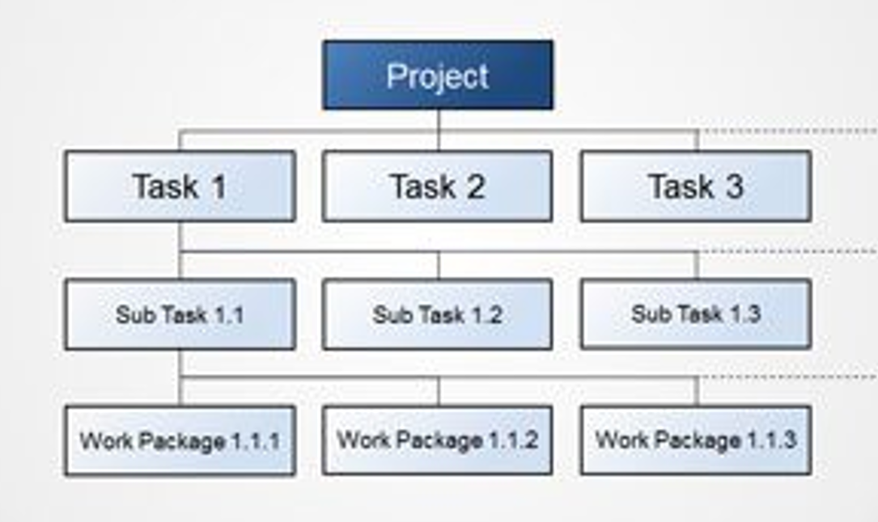
Notes:
phân nhóm theo định hướng phân phối của công việc

Slide 18
Approaches to Developing WBSs
The analogy approach: Review WBSs of similar projects and tailor to your project
The top-down approach: Start with the largest items of the project and break them down (large)
The bottom-up approach: Start with the specific tasks and roll them up (small)
Mind-mapping approach: Mind mapping is a technique that uses branches radiating out from a core idea to structure thoughts and ideas (both)
Notes:
To tailor = to adjust
This might be very helpful - If you have a similar project, you could tailor it to your project.
For example, if I have an eCommerce website and I have already worked on similar kind of project.
That is simple for me to break down based on past experience.

Slide 19
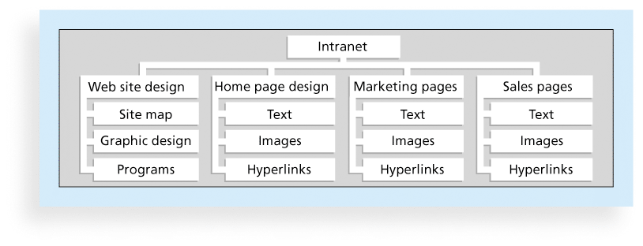
Figure 5-3. Sample Intranet WBS Organized by Product
Notes:
https://creately.com/blog/examples/work-breakdown-structure-templates/

Slide 20
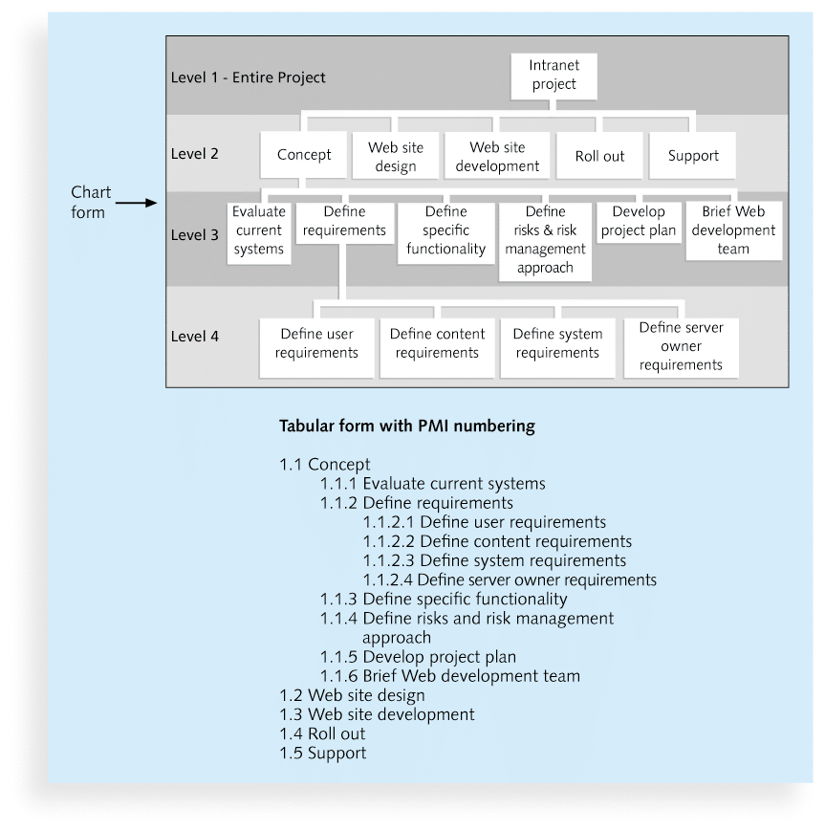
Figure 5-4. Sample Intranet WBS Organized by Phase

Slide 21
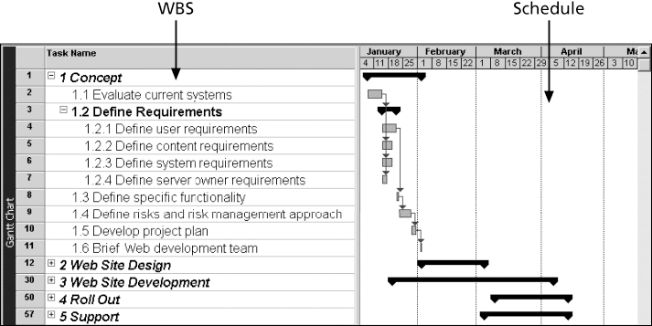
Figure 5-5. Intranet WBS and Gantt Chart in Microsoft Project

Slide 22
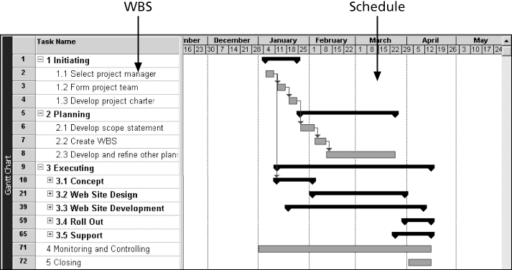
Figure 5-6. Intranet Gantt Chart Organized by Project Management Process Groups

Slide 23
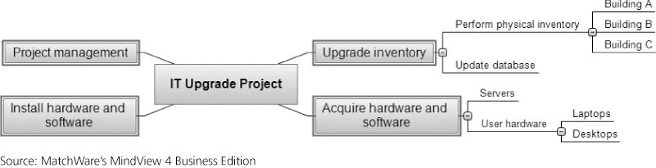
Figure 5-7. Sample Mind-Mapping Approach for Creating a WBS

Slide 24
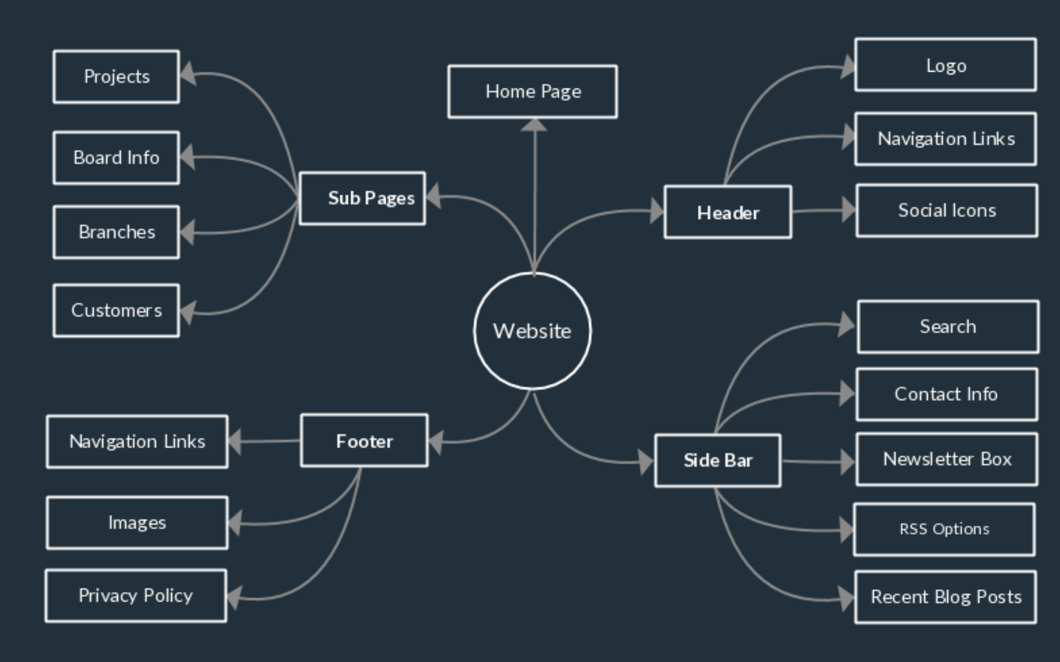

Slide 25
The WBS Dictionary and Scope Baseline
Many WBS tasks are vague and must be explained more so people know what to do and can estimate how long it will take and what it will cost to do the work
A WBS dictionary is a document that describes detailed information about each WBS item

Slide 26
5.5.Validating Scope
It is very difficult to create a good scope statement and WBS for a project
It is even more difficult to verify project scope and minimize scope changes
Scope validation involves formal acceptance of the completed project deliverables
Acceptance is often achieved by a customer inspection and then sign-off on key deliverables

Slide 27
5.6.Controlling Scope
Scope control involves controlling changes to the project scope
Goals of scope control are to
influence the factors that cause scope changes
assure changes are processed according to procedures developed as part of integrated change control, and
manage changes when they occur
Variance is the difference between planned and actual performance

Slide 28
Suggestions for Reducing Incomplete and Changing Requirements
Develop and follow a requirements management process
Use techniques such as prototyping, use case modeling.
Put requirements in writing and keep them current
Create a requirements management database for documenting and controlling requirements

Slide 29
Suggestions for Reducing Incomplete and Changing Requirements (cont’d)
Provide adequate testing and conduct testing throughout the project life cycle
Review changes from a systems perspective
Emphasize completion dates to help focus on what’s most important
Notes:
Emphasize: nhấn mạnh

Slide 30
Using Software to Assist in Project Scope Management
Word-processing software helps create several scope-related documents
Spreadsheets help to perform financial calculations, weighed scoring models, and develop charts and graphs
Communication software like e-mail and the Web help clarify and communicate scope information
Project management software helps in creating a WBS, the basis for tasks on a Gantt chart

Slide 31
Chapter Summary
Project scope management includes the processes required to ensure that the project addresses all the work required, and only the work required, to complete the project successfully
Main processes include
Define scope management
Collect requirements
Define scope
Create WBS
Validate scope
Control scope

Slide 32
BT tuần 3:
Làm đề tài theo nhóm về (QL tích hợp, QL Phạm vi)
Tóm tắt lý thuyết (học bài)
Ứng dụng vào đề tài
File: STTNhom_BT tuan3
DS Nhóm:
STT_MSSV_Hoten
STT_MSSV_Hoten
STT_MSSV_Hoten
Nộp bài trên LMS: hết ngày 8/9

